Slide 1


Huazhong University of Science and Technology
The Department of Electronics and Information Engineering
Electronic Circuit Analysis and Design
Dr. Tianping Deng
Email: dengtp@hust.edu.cn

Slide 2
Contents
PART 1 SEMICONDUCTOR DEVICES AND BASIC APPLICATIONS
Chapter 1 Semiconductor Materials and Diodes
Chapter 2 Diode Circuits
Chapter 3 The Field-Effect Transistor
Chapter 4 Basic FET Amplifiers
Chapter 5 The Bipolar Junction Transistor
Chapter 6 Basic BJT Amplifiers
Chapter 7 Frequency Response
Chapter 8 Output Stages and Power Amplifiers
PART 2 ANALOG ELECTRONICS
Chapter 9 Ideal Operational Amplifiers and Op-Amp Circuits
Chapter 10 Integrated Circuit Biasing and Active Loads
Chapter 11 Differential and Multistage Amplifiers
Chapter 12 Feedback and Stability
Chapter 13 Operational Amplifier Circuits
Chapter 14 Nonideal Effects in Operational Amplifier Circuits
Chapter 15 Applications and Design of Integrated Circuits
Chapter 12 Feedback and Stability

Slide 3
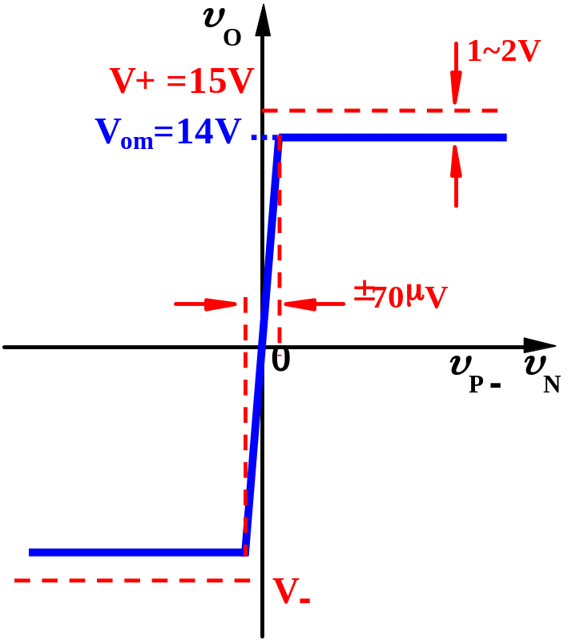
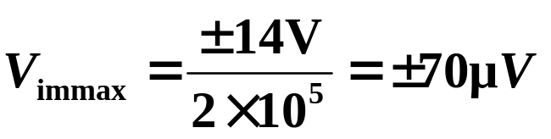
Preview
OP-AMP
Very good diff-amp
But… Some problem？
1. A_{VO} ≈ 2×10⁵ (106dB)
How to use it？
±V_{OPP} ＝ ±14V（V_{om}）
2. f_{H} ≈ 7Hz
Frequency distortion
Reduce nonlinear distortion
How to solve
those problem？
Negative feedback
Extend the bandwidth

Slide 4



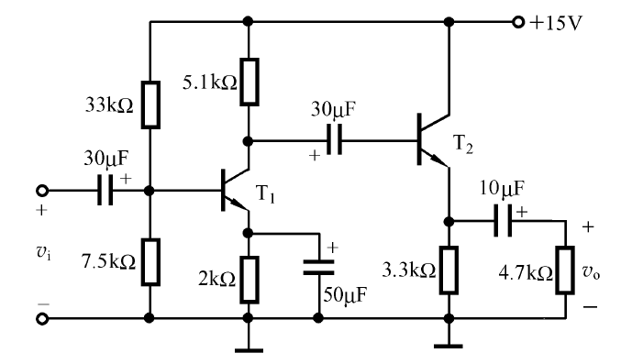



Ch12 Feedback and Stability

Slide 5
Ch12 Feedback and Stability
12.0 Preview
12.1 Introduction to Feedback
12.2 Basic Feedback Concepts
12.3 Ideal Feedback Topologies
12.4 voltage (Series-Shunt) Amplifiers
12.5 Current (Shunt-Series) Amplifiers
12.6 Transconductance (Series-Series) Amplifiers
12.7 Transresistance (Shunt-Shunt) Amplifiers
12.8 Loop Gain
12.9 Stability of the Feedback Circuit
12.10 Frequency Compensation
12.11 Summary

Slide 6







Feedback is commonly used in amplifier circuits. There
are two types of feedback.
In negative feedback, output signal (or portion of it) is fed back to input side and is subtracted from input signal.
In positive feedback, output signal (or portion of it) is
fed back to input side and added to input signal.

Slide 7
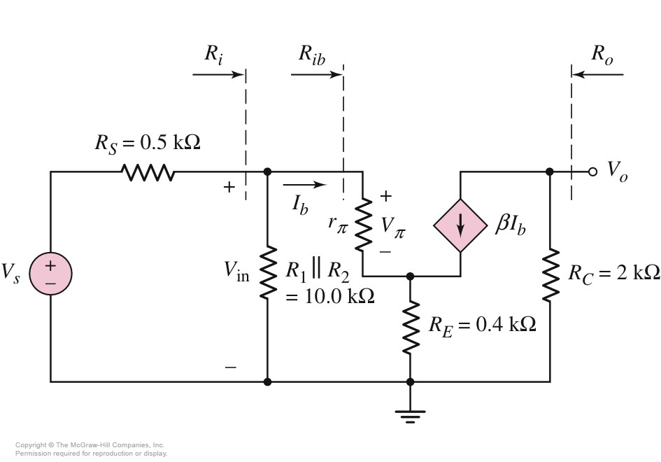
External feedback

Slide 8
Basic Feedback Concepts
⑴ Feedback
⑵ Positive and negative feedback
⑶ AC and DC feedback
⑷ series and shunt
⑸ Examples

Slide 9

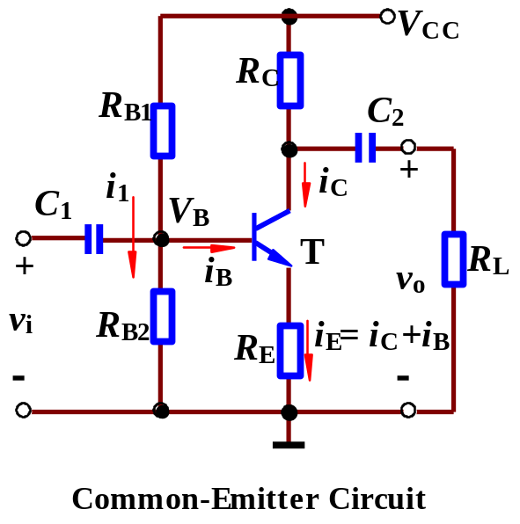
1. Feedback
In a feedback system, a signal that is proportional to output is fed back to input and combined with input signal to produce a desired system response.
External feedback

Slide 10
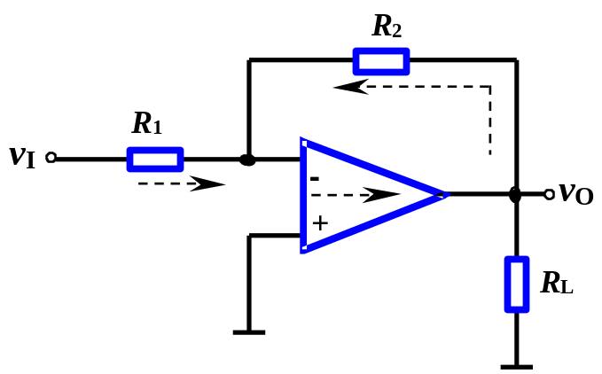
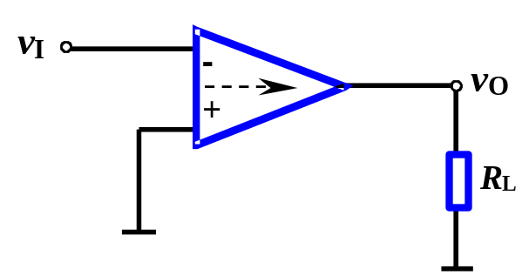
1. Feedback
Feedback circuit—Output signal is transmitted back to input loop through it.
Feedback
network
Open-loop ——no feedback network.
Open-loop amp
Closed-loop ——has feedback network.

Slide 11
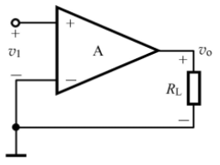
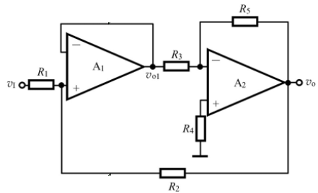
Find the feedback network in the circuit.
Feedback in stage
Feedback in stage
Feedback between two stages

Slide 12
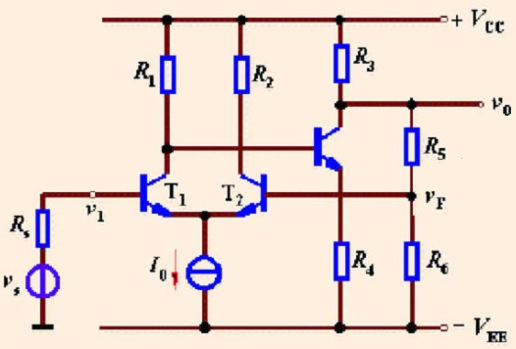
Find the feedback network in the circuit.
Feedback between two stages

Slide 13
2. Types of Feedback
（1）Positive and negative feedback
Positive: With feedback, Output increases, when input signal is same.
Negative: With feedback, output decreases, when input signal is same.
Or
Positive: With feedback, net signal increases.
Negative: With feedback, net signal decreases.
Recognizing method: Instantaneous polarities. From input, Labeling the changing slopes of voltages along the direction of signal going with “+”, “-”signs at some instant.

Slide 14
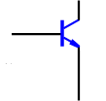



2. Types of Feedback
（1）Positive and negative feedback
net signal
net signal can be voltage or current.
net signal
voltage
net signal
voltage
net signal
voltage

Slide 15
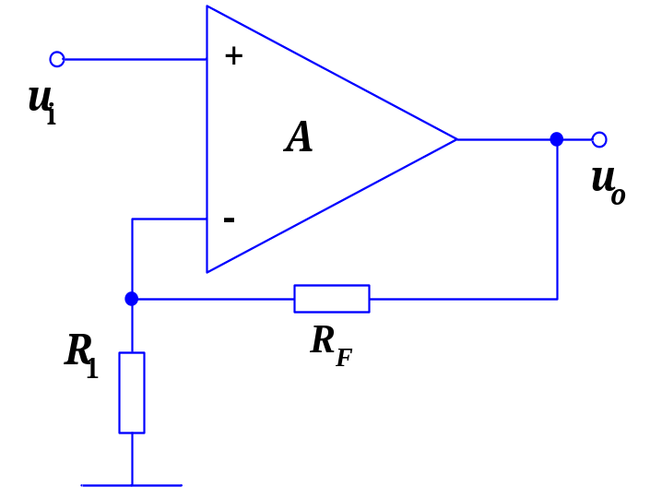

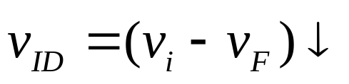
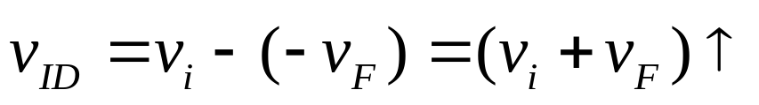
The phase of the op-amp
v_{P}
＋
v_{P}
＋
－
＋
v_{ID}
v_{ID}
－
－
v_{N}
v_{N}
＋
－
v_{F}
v_{F}
－
＋
negative feedback
Positive feedback
The noninverting input terminal and the output terminal has the same phase
The inverting input terminal and the output terminal has the opposite phase

Slide 16
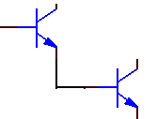
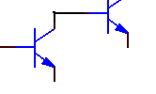
The phase of the discrete device
♣ For BJT
The collector terminal and the base terminal has the opposite phase.
The Emitter terminal and the base terminal has the same phase.
(-)
(+)
(+)
(+)
CC
CE
Emitter terminal and the
base terminal has the same phase.
collector terminal and the base
terminal has the opposite phase.

Slide 17
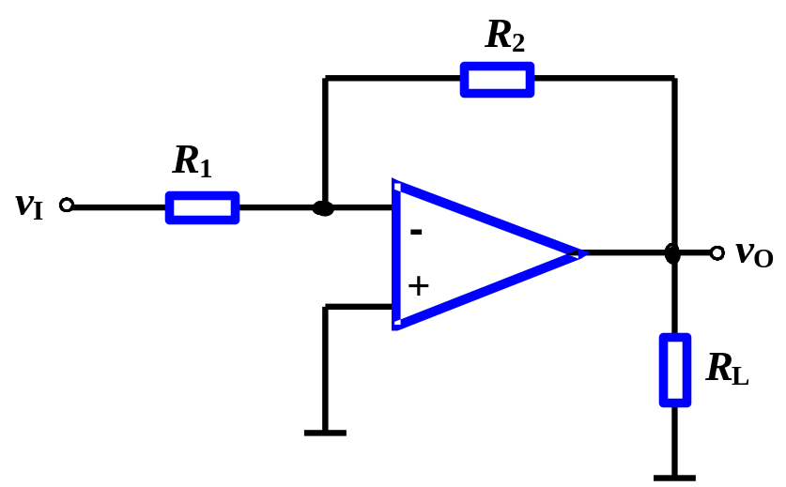
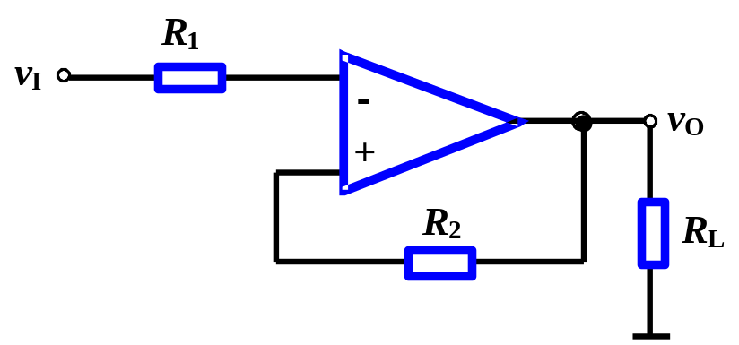
（1）Positive and negative feedback
Example 1
net signal
feedback
Negative
Positive
(-)
(+)
(+)
(-)
(-)
(+)
(+)
(-)
(-)
feedback
net signal

Slide 18
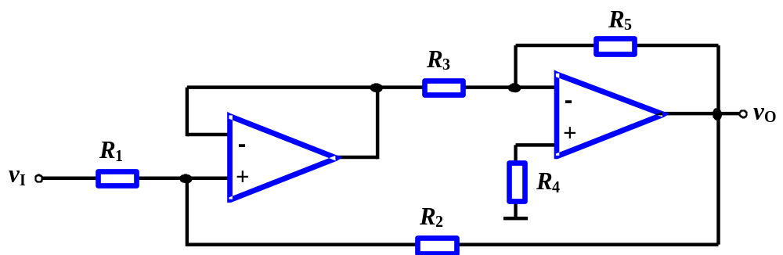
（1）Positive and negative feedback
Example 2
Feedback in stage
反馈通路
Net signal
(+)
(-)
(+)
(+)
(+)
(-)
Negative between two stages
Feedback between two stages

Slide 19
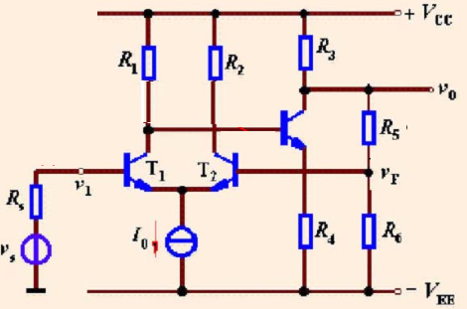
（1）Positive and negative feedback
Net signal
decreases
Feedback between two stages
Negative between two stages

Slide 20
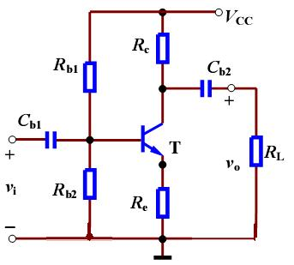
（1）Positive and negative feedback
Negative in stage
Feedback in stage
Net signal
decreases

Slide 21
2. Types of Feedback
（2）AC and DC feedback
Recognizing method: If the feedback signal is ac (or dc) values, it is an ac (or dc) feedback.

Slide 22
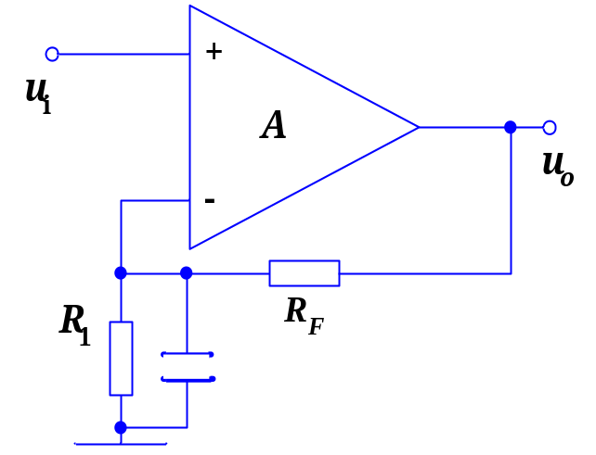
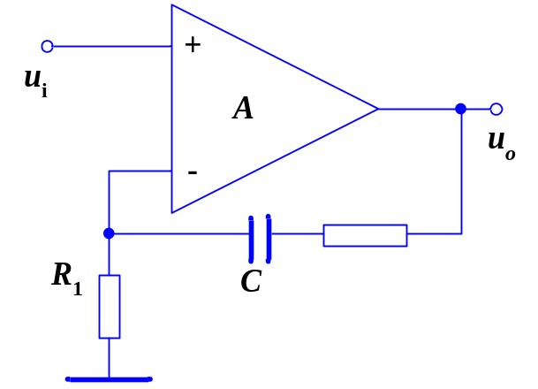

（2）AC and DC feedback
coupling capacitor
AC and DC
feedback
bypass capacitor
AC feedback
DC feedback

Slide 23
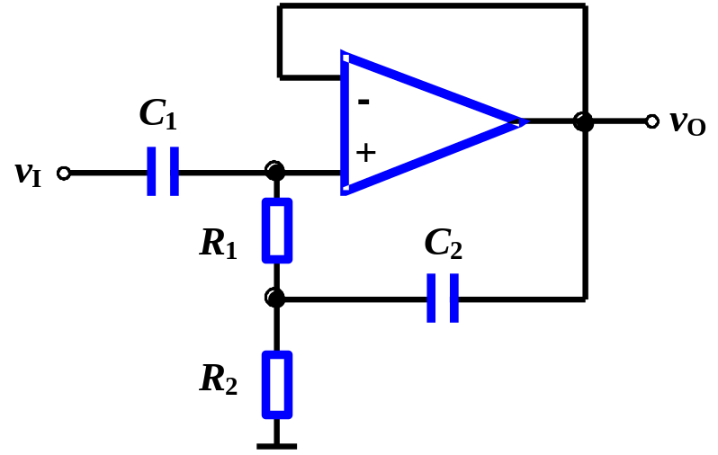
2. Types of Feedback
（2）AC and DC feedback
Example
Ac and dc feedback
(+)
(+)
(+)
(+)
(+)
Positive ac feedback

Slide 24
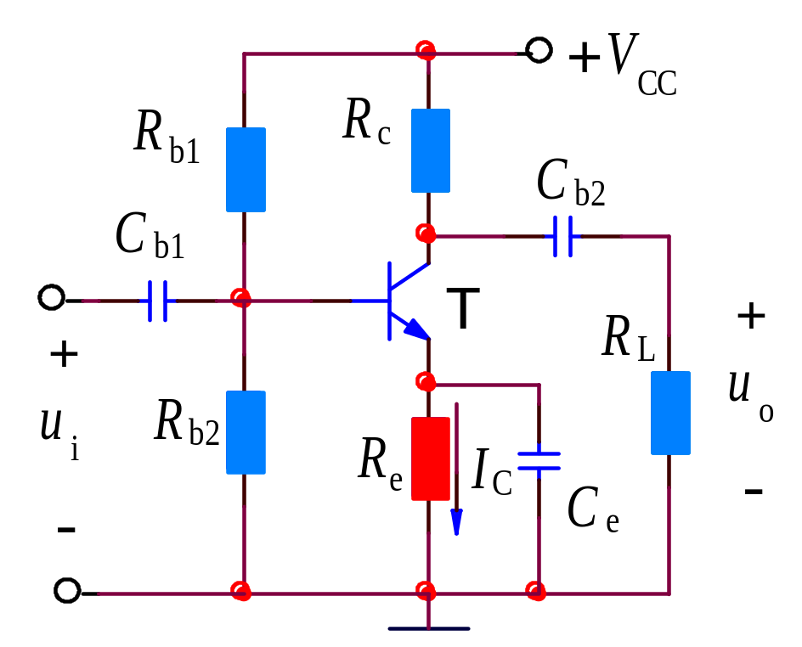

（2）AC and DC feedback
i_{c}
DC
AC

Slide 25
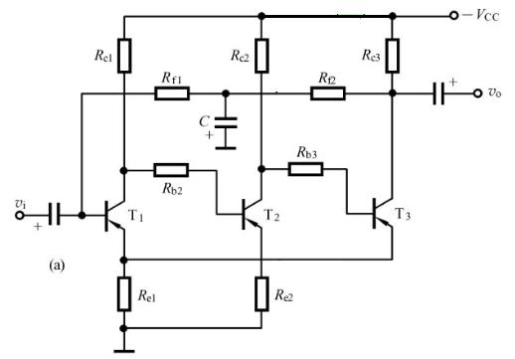
（2）AC and DC feedback
DC feedback
bypass capacitor
AC and DC
feedback

Slide 26






Slide 27
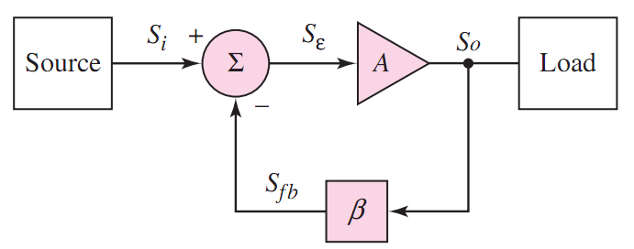

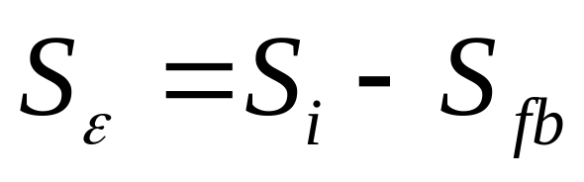

Slide 28








Slide 29





0

Slide 30


Slide 31



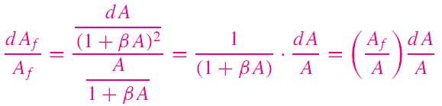




Slide 32
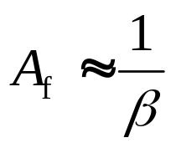
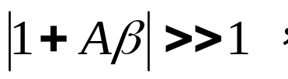
Sensitivity of A_{f} becomes very small.
When
A_{f} only depends on feedback network, so feedback components should be linear and stable.

Slide 33


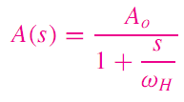




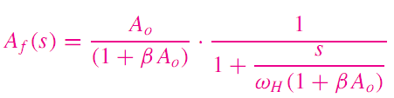

Slide 34
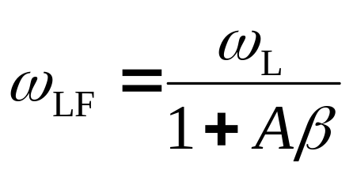
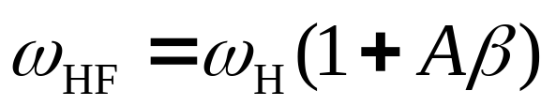






Lower 3dB is reduced by a factor of (1+Aβ)
Upper 3dB is extended by a factor of (1+Aβ)
Open-loop
Closed-loop

Slide 35
A(f)
A_{f}(f)
A_{m}
0707A_{m}
A_{mf}
0707A_{mf}
BW
BW_{f}
O
f_{Lf}
f_{L}
f_{H}
f_{Hf}
f

Slide 36
12.2.5 Reducing nonlinear distortion
No feedback
Distortion
u_{i}
A
u_{o}
with feedback
u_{d}
improved
u_{i}
+
u_{o}
∑
A
u_{o}
–
u_{f}
F
The basic idea of negative feedback is to trade off gain for
Reducing nonlinear distortion.

Slide 37
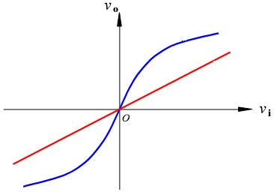
12.2.5 Reducing nonlinear distortion
Open-loop
closed-loop

Slide 38
Questions
and
Answers

